Slide 1

Graphics and Computational Programming
James Comer

Slide 2
Features
Spheres, planes, cubes, and cylinders
PBR (or Blinn-Phong)
Shadows
Ambient occlusion
Reflectivity
Transparency and refraction
Real time with menus to adjust values
Multi-threaded
Uses thread pooling
Adjust number of tasks a frame is split into independent of the number of threads.

Slide 3
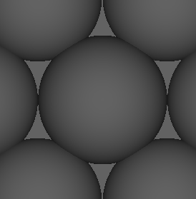
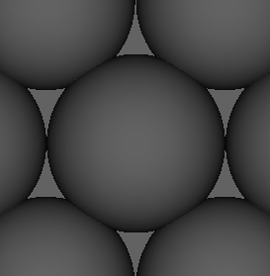
Theory – ambient occlusion
Ambient occlusion is the idea that a point will not receive as much ambient light if there are objects near it.
It is used to simulate soft shadows that should occur due to indirect lighting.
Technically ambient occlusion should not occur at points in direct light, but since I don’t have indirect lighting I just apply it everywhere.
Notes:
Ambient occlusion reduces ambient light at points near other objects, simulating soft shadows from indirect lighting. While AO shouldn't apply in direct light, I apply it everywhere due to not having indirect lighting.

Slide 4
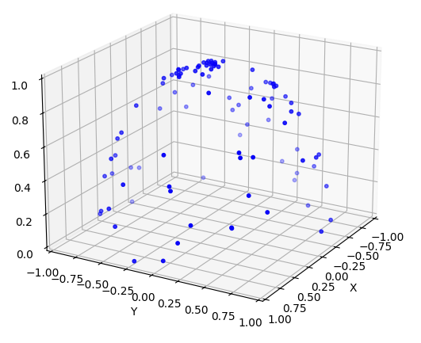
Theory – ambient occlusion
Generate a number of points on a hemisphere and normalise these to use them as direction vectors. Invert any that are past 90 degrees from the normal of the point we’re looking at.
If a sample hits something within out specified range we are more occluded and less ambient light should reach this point.
Notes:
To calculate AO, I generate hemisphere points which are used as direction vectors, flipping any beyond 90° from the surface normal of the point we’re looking at using the dot product. If a sample hits within a range, it reduces ambient light. No hits mean full ambient light; all hits mean none. The graph shows 64 points generated by my code and put into python for visualization.

Slide 5
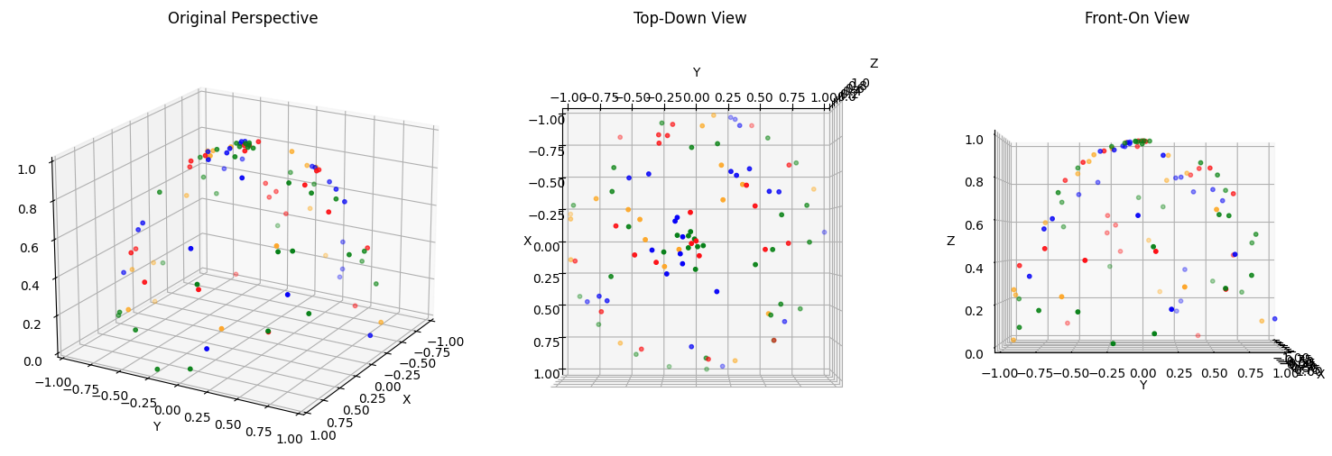
Theory – ambient occlusion
Optimised to split samples into smaller groups and test groups one by one. We exit early when no new samples hit something. Avoids testing lots of samples unnecessarily.
Greatly increases performance in scenes where there is less ambient occlusion.
Sample splitting creates false negative where we exit early assuming no ambient occlusion when, if we tested more samples, we’d find there is some.
Notes:
Initially, every point checked all samples, wasting time on empty areas. I optimized by testing smaller sample groups and stopping early if no collisions are found in a group. This improves performance but can create minor false negatives where occlusion is missed.

Slide 6
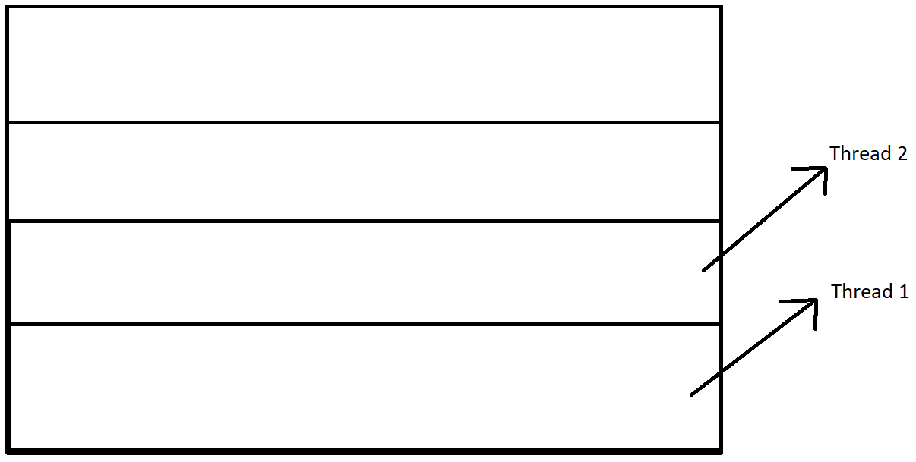
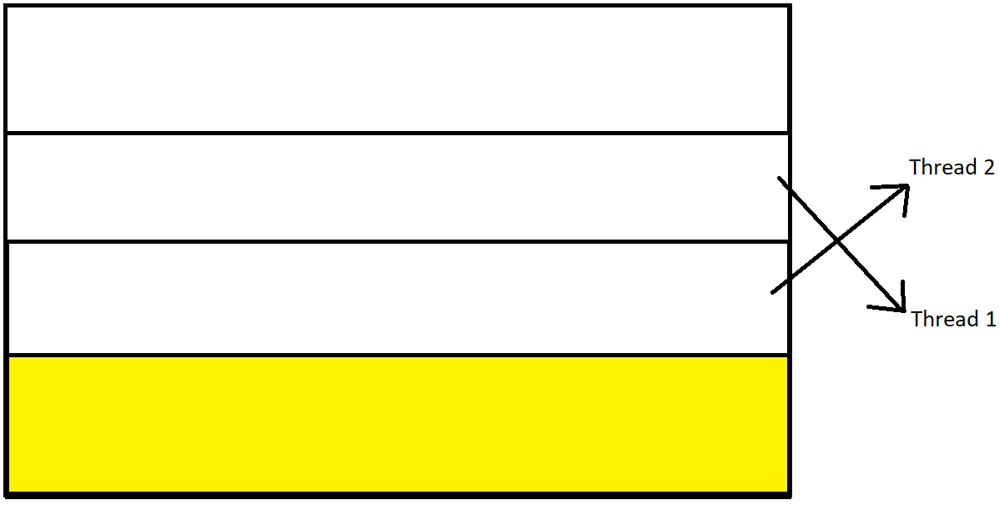
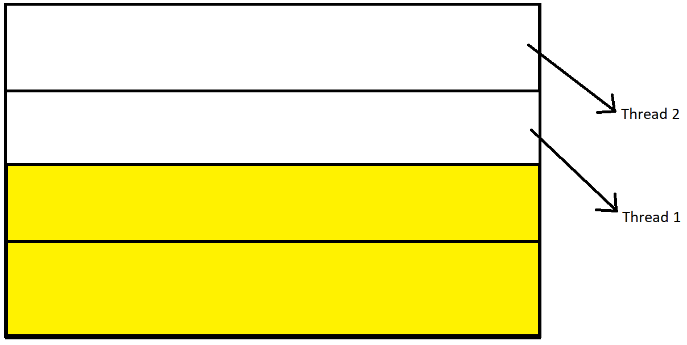
Design
The number of tasks dictates how many separate groups of pixels the screen is split up into.
Those tasks are sent off to the thread pool where one thread will work on one task until it’s done, then that thread will work on the next task that isn’t getting worked on.
Tasks can be set independently from threads.
Notes:
The number of tasks dictates how many separate groups of pixels the screen is split up into. Those tasks are sent to the thread pool where one thread will work on one task until it is done, then that thread will start working on the next task available that isn’t already being worked on. Tasks can be set independently from threads. So a lower number of tasks than threads will theoretically simulate that number of threads, with the rest of the actual threads not having any tasks to work on.

Slide 7
Analysis
All tests use
- 640 x 480 resolution.
- Average frame time over 10 frames, all recorded in ms.
- Core i7-13700 16 core CPU.
Notes:
All of my test use 640 by 480 resolution, they all take the average frame time in milliseconds over 10 frames, and they were all done on a core i7- 13 7 hundred which is a 16 core CPU with 24 logical processors. It is also worth noting that each test was done on different days, so comparing specific data values from test 1 with test 2 for example may not be reliable, but the tests with multiple data points were performed all in one go.

Slide 8
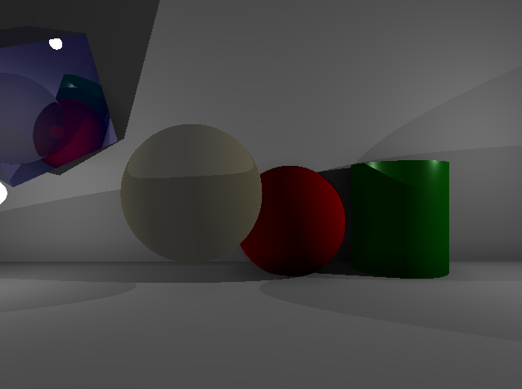
Analysis – test 1, threads
Using scene 1 with 64 ambient occlusion samples with a split of 1.
Tested 1 to 500 threads to see the difference in frame time.
Use the same number of tasks as the number of threads so each thread has one equal portion of pixels to render.
Notes:
Test 1 was to test how threads affect performance. I used scene 1 with 64 ambient occlusion samples at 1 split. I tested 1 to 500 threads to see the difference in frame time. I also used the same number of tasks as the number of threads so each thread has one equal portion of pixels to render.

Slide 9
Analysis – test 1, threads
Notes:
As you can see there is an initial steep fall off in frames with 1 thread taking 1906 milliseconds and 2 threads taking 1042 milliseconds. The graph starts to level out at around 8 threads.

Slide 10
Analysis – test 1, threads
Notes:
Here I have cut off the results from 1 to 13 to allow us to see the results in more detail. The fastest average frame time was 37 threads at 176.85, with the results seeming to increase from there. Interestingly, the results increase until around 239 threads where they level off.

Slide 11
Analysis – test 1, threads
From 37 – 239 threads
Number of threads exceeds the number of logical processors leading to more context switching as the OS shares CPU time among threads.
From 240 – 500 threads
The OS stablises its scheduling overhead and additional threads mostly remain idle waiting for an active thread to stop needing CPU time.
Notes:
So from 37 to 239 threads, we see the frame time increasing because the number of threads exceeds the number of logical processors leading to more context switching as the operating system shares CPU time among threads. The CPU can only do tasks simultaneously on its logical processors, our CPU has 24 logical processors, so we can assume that the benefit of extra threads taking on work out-weighed the overhead of context switching in the range of 24 to 37 threads. In the range 240 to 500 threads, the operating system stablises its scheduling overhead and additional threads remain idle, waiting for an active thread to stop needing CPU time. The fact that the results started plateauing at 240 threads when we have 24 logical processors seemed too coincidental, like maybe one logical processor can only handle 10 tasks, but after some research it seems that that is not the case and the number is purely coincidental, there is no hard limit on threads a logical processor can handle at once.

Slide 12
Analysis – test 2, threads & tasks
Using scene 1 with 64 ambient occlusion samples with a split of 1.
Tested continuous number of tasks (up to 256) against set number of threads.
Notes:
Test 2 was to test how the number of tasks impacts the performance against threads. My prediction was that less tasks than threads is simulating that lower number of threads as the rest of the threads will be idle, so all the threads should decrease in frame time as the tasks decrease and then break away from the rest of the threads once their number of threads is exceeded by tasks.

Slide 13
Analysis – test 2, threads & tasks
Notes:
My prediction was mostly correct however not as drastic as I had thought. You can see that initially the results are almost identical at a low number of tasks.

Slide 14
Analysis – test 2, threads & tasks
Notes:
I have cut off the first 6 results to allow us to see the graph in more detail. We can see that when 8 threads exceeds 8 tasks it breaks off from the rest and plateaus getting gradually quicker with more tasks, and the same for 16 threads. However all the rest of the threads are almost identical. 32 threads tends to be the slowest on average but not by much. We can relate this data back to test 1, where we see the performance doesn’t improve past 37 threads. I am pleased with the result at 16 threads however, with a noticeable decrease in frame time as tasks increase. We can assume this is because while one thread is working on a long task, other threads can work on many smaller ones at the same time making it more efficient. This effect increases as we add more tasks.

Slide 15
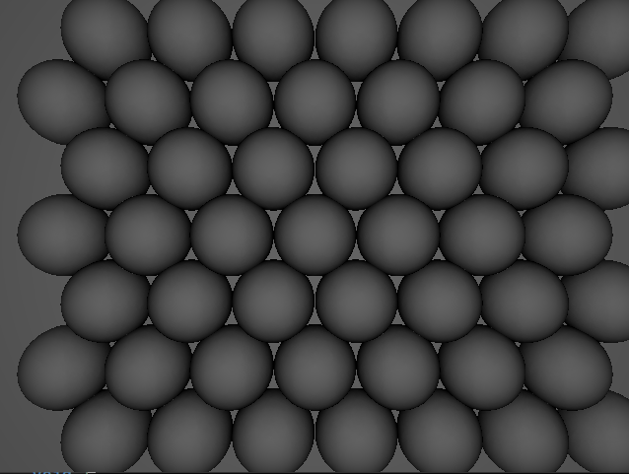
Analysis – test 3, ambient occlusion
Tested different ambient occlusion sample sizes, as well as different number of splits on scene 2 and then scene 1 to see the difference in frame time between differently split samples, and then see how the percentage change differs on a different scene.
Tests done with 24 threads and 24 tasks.
Notes:
Test 3 was to test different ambient occlusion sample sizes, as well as different number of splits on scene 2 and then scene 1 to see the difference in frame time between differently split samples, and then see how the percentage change differs on a different scene. Tests done with 24 threads and 24 tasks.

Slide 16
Analysis – test 3, ambient occlusion
Notes:
As you can see there is a noticeable increase in performance with more splits being faster than less splits. The results for 4, 5, and 6 splits are very close. This is likely because the difference in the number of samples in each split is small so, looking at one point, the chances of (for example) 12 equally distributed samples not hitting and allowing for an early exit and 10 samples not hitting and allowing for an early exit are very low.

Slide 17
Analysis – test 3, ambient occlusion
Notes:
In a scene where a lot less points require ambient occlusion we see a much bigger increase in performance with an increased number of splits. This is because we can exit early on a lot more points, requiring the code to check a lot less samples.

Slide 18
Analysis – test 3, ambient occlusion
Percentage change from splits | 1 to 2 | 1 to 3 | 2 to 3
Scene 1 | 37.62 | 48.75 | 17.84
Scene 2 | 11.70 | 17.89 | 7.01
The optimisation is a lot more effective in a scene with less points that have ambient occlusion.
Notes:
Here you can see the percentage change in frame time. For this I have averaged the frame time over all threads for 1 splits, 2 splits, and 3 splits for each scene. It is clear to see there is a much bigger percentage change in scene 1 compared to scene 2 for the reasons I have already discussed.

Slide 19
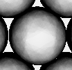
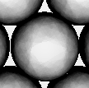
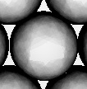
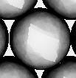
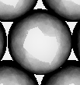
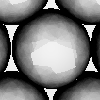
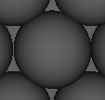
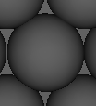
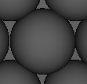
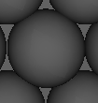
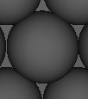
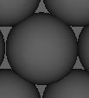
Analysis – test 3, ambient occlusion
1 split
2.5 fps
2 split
2.9 fps
3 split
3.0 fps
4 split
3.2 fps
5 split
3.3 fps
6 split
3.3 fps
Notes:
Here is a visual comparison of the different number of splits. These pictures were rendered with 64 ambient occlusion samples. For the top row of images, ambient light is at a much higher value then you would usually have and ambient strength is at 2 which means it is 2 times darker than it would normally be to help visualisation. The bottom images are in a lot more realistic scenario. Looking at the top images it’s clear to see how each frame gets affected by a lower number of splits. You can see the false negatives on the top of the ball, usually having an abrupt change to a darker colour as the code realises it shouldn’t be exiting yet. You can also see from the images below that actually the difference isn’t very noticeable. If you look closely you can see the false negatives on the top of the ball from split 4 and up but only because of the abrupt change to a darker colour. In my opinion split 3 has very negligible visual changes whilst gaining 0.5 fps on split 1.

Slide 20
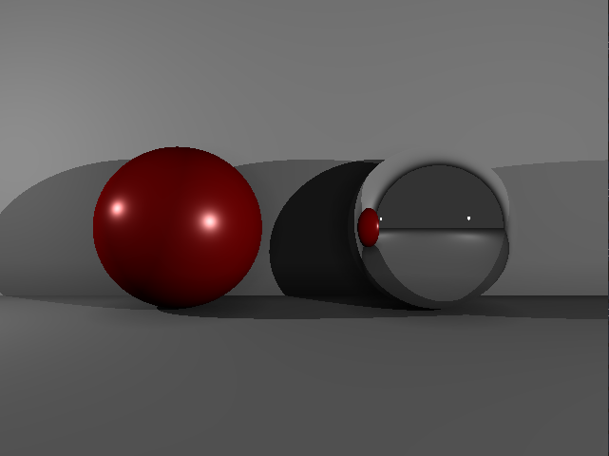
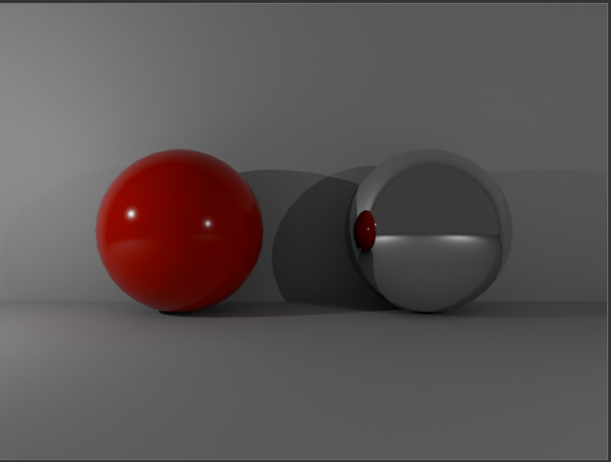
Qualitative
My scene
Blender scene
Notes:
Comparing my results to a scene in blender there are a few key differences. A main difference I think is the shadows. Mine is very dark where the shadows overlap and darker overall, whilst blender had much softer shadows, particularly the shadow to the left of the red ball. Another big difference for me is the lack of anti aliasing in my output. Both images are the same resolution but you can clearly see each pixel in my scene making edges look jagged. Some positives are that the colour of the background is very similar, meaning my PBR equations must be good, and the reflection in the mirror balls look very similar showing my reflections are working how intended.

Slide 21
References
All images were my own.
Notes:
All of these images have been my own. Thank you for watching.

